Slide 1
Kidney stone detection using DIP
AKSHAY P BHAGWAT 1BI20CS017
BENAKA ADITYA 1BI20CS039
ARYAMAN JALALI 1BI20CS032
AAYUSH 1BI20CS002

Slide 2
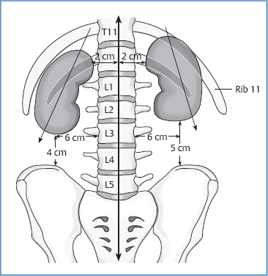
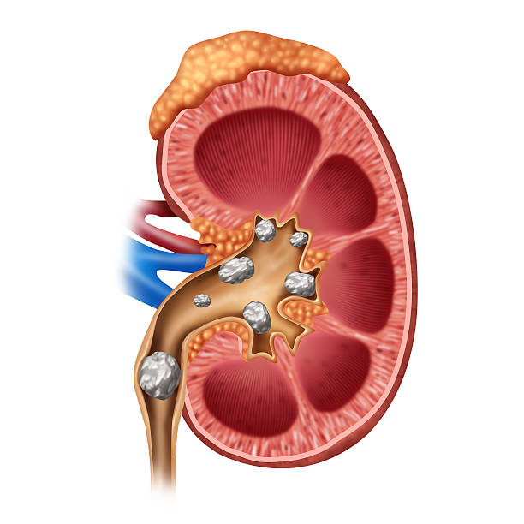
Biology and anatomy of kidney
Where is kidney in the body?
Between 12th thoracic and 3rd lumbar vertibrae

Slide 3
Biology and anatomy of kidney
Function of kidney?
Filtering blood, excreting toxins, minerals & vitamins.
Electrolyte balance, Ph balance, blood pressure
What causes kidney stones? And density of kidney stones

